Slide 1
Posture and Workout detection
By: Ari (Sara) Wahl ,Nourhan Omar, Pavlo Kravets, Polina Kozyr and Vipin Singh

Slide 2
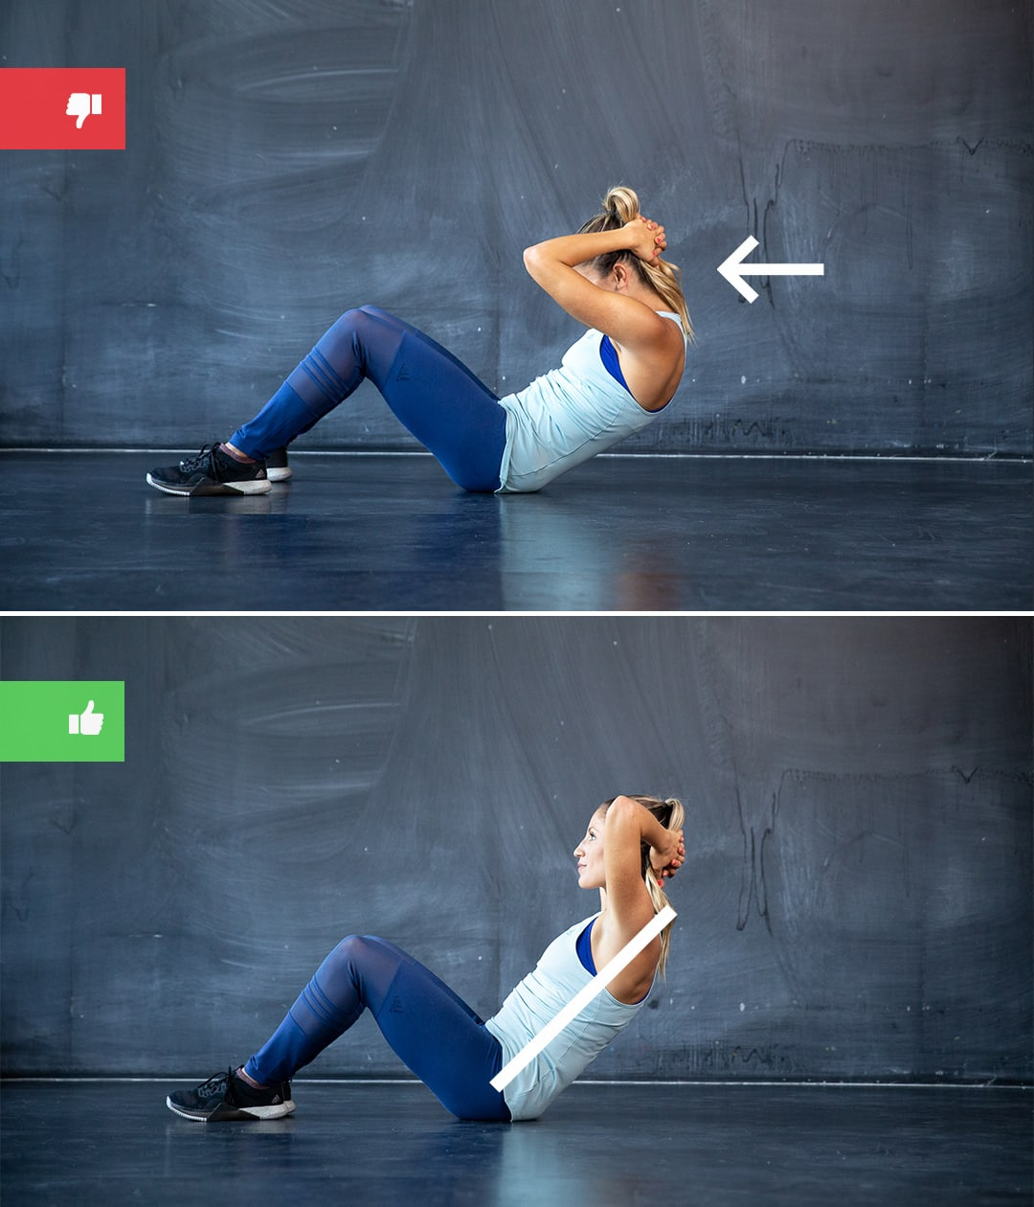
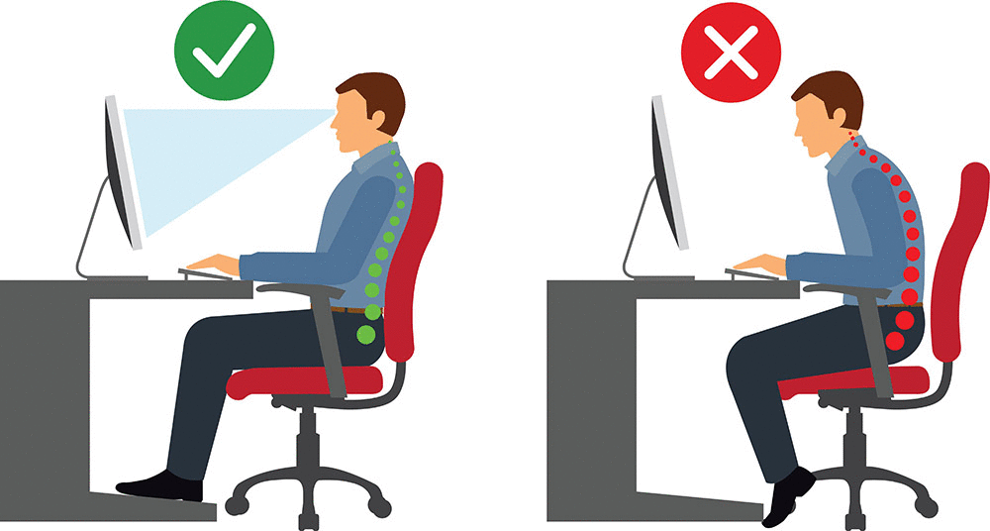
Business Idea Proposal
The main goal of the app is to help people become healthier
This is done by the help of image processing and movement detection
The app would have two main parts: posture and working out
It would detect the movements and instruct to correct the wrong ones helping the body keep its best and healthiest shape

Slide 3
References
https://www.healthdirect.gov.au/how-to-improve-your-posture
https://www.runtastic.com/blog/en/bodyweight-exercise-mistakes/

